Slide 1

Movie Recommendation System
- Mohamed Abdelrahman
- Nada Hamdi
- Mai Abdallah
- Marwan Sayed
- Abdelhady Mohamed

Slide 2

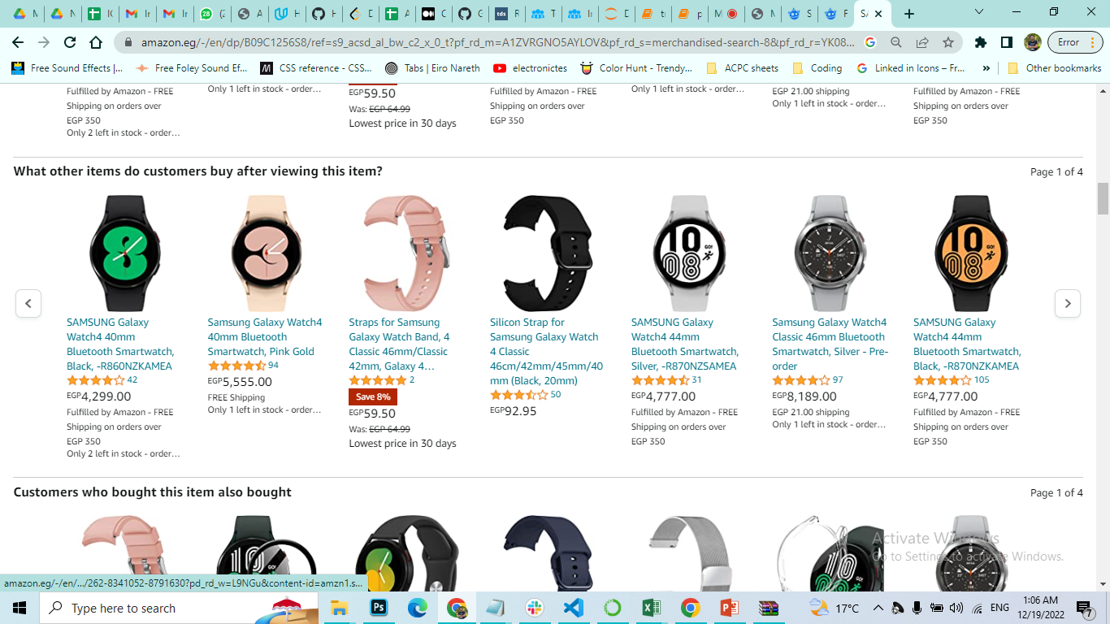
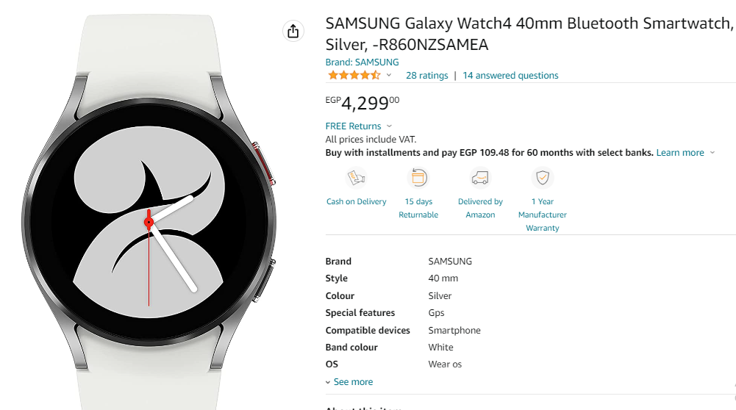
Why Recommendation systems ?
Movie Recommendation System

Slide 3

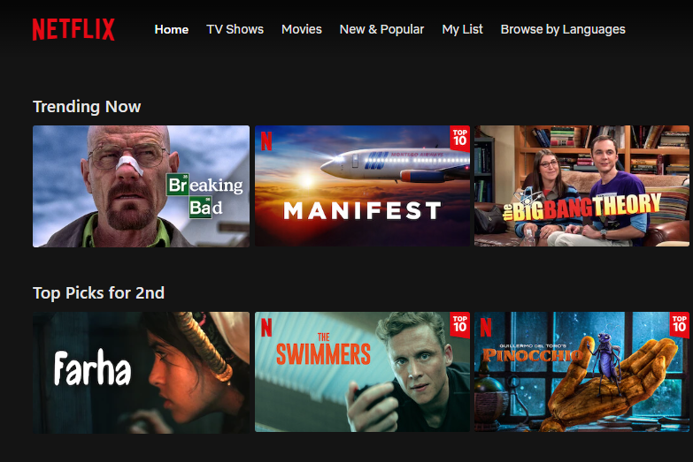
Why Recommendation systems ?
Movie Recommendation System

Slide 4

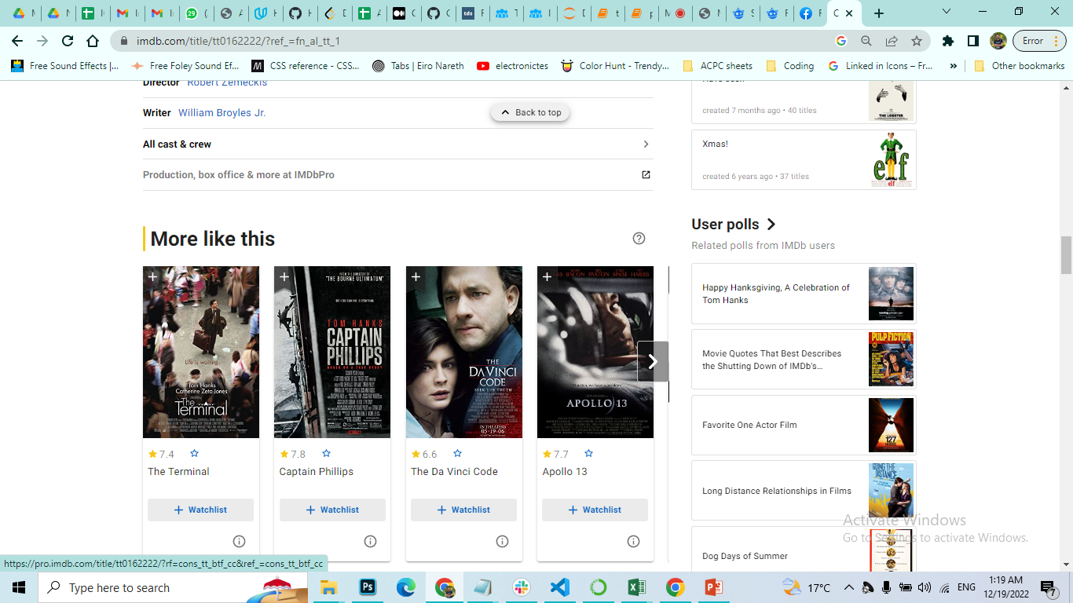
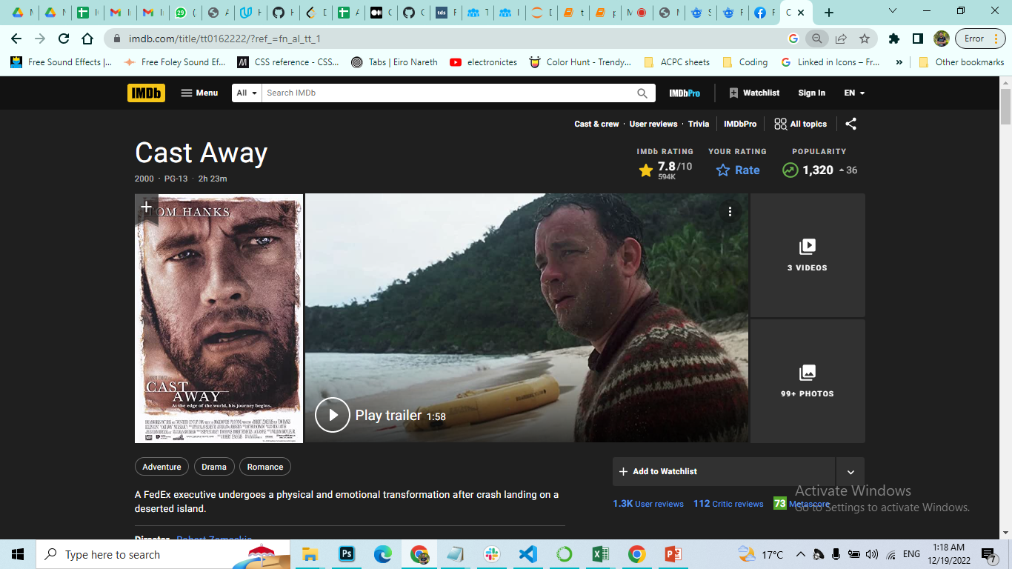
Why Recommendation systems ?
Movie Recommendation System

Slide 5
What is a Recommendation System ?
Recommendation engines are a subclass of machine learning which generally deal with ranking or rating products / users. The results which are generated are often recommendations for the user for things that they need / want but are unaware that they need / want it until they’ve been recommended to them.
There are many different ways to build recommender systems, some use algorithmic and formulaic approaches like Page Rank while others use more modelling centric approaches like collaborative filtering, content based, Hybrid recommender systems, etc.
Movie Recommendation System

Slide 6
Types :-
Collaborative Filtering Systems :-
Collaborative filtering is the process of predicting the interests of a user by identifying preferences and information from many users. This is done by filtering data for information or patterns using techniques involving collaboration among multiple agents, data sources, etc. The underlying intuition behind collaborative filtering is that if users A and B have similar taste in a product, then A and B are likely to have similar taste in other products as well.
YouTube content recommendation to users — recommending you videos based on other users who have subscribed / watched similar videos as yourself.
CourseEra course recommendation — recommending you courses based on other individuals who have finished existing courses you’ve finished.
Movie Recommendation System

Slide 7
Types :-
Content Based Systems :-
Content based systems generate recommendations based on the users preferences and profile. They try to match users to items which they’ve liked previously. The level of similarity between items is generally established based on attributes of items liked by the user. Unlike most collaborative filtering models which leverage ratings between target user and other users, content based models focus on the ratings provided by the target user themselves.
Amazon product feed (you’re being recommended products similar to what you’ve previously purchased)
Spotify music recommendations
Movie Recommendation System

Slide 8
And this is what we are interested in today
Content-Based Systems
Movie Recommendation System

Slide 9
Why Content-Based Systems ?
The model doesn't need any data about other users, since the recommendations are specific to this user. This makes it easier to scale to a large number of users.
The model can capture the specific interests of a user, and can recommend niche items that very few other users are interested in.
You avoid the ‘‘cold start’’ problem. Collaborative filtering creates a potential cold start scenario when a new website or community has few new users and lacks user connections.
Recommendations are highly relevant to the user bolstering their trust level in offered recommendations. Comparatively, with collaborative filtering, instances are more likely to occur where users don’t understand why they see specific recommendations.
Movie Recommendation System

Slide 10

Now…
We searched for a dataset that
satisfy our needs
Movie Recommendation System

Slide 11

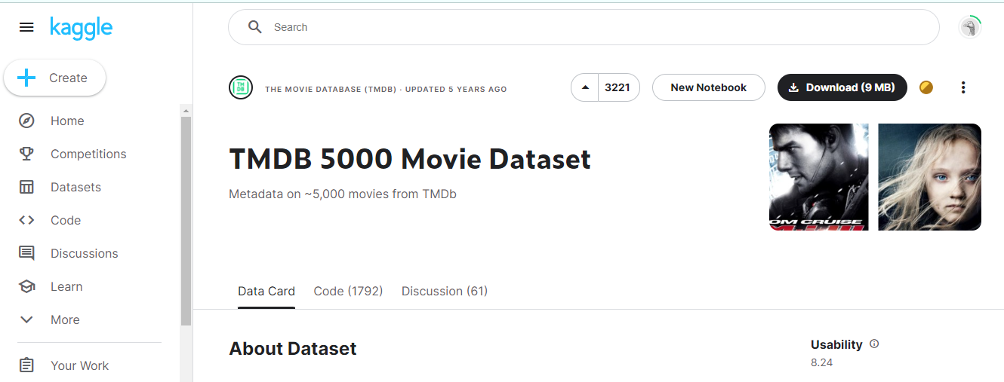
Dataset
Movie Recommendation System

Slide 12
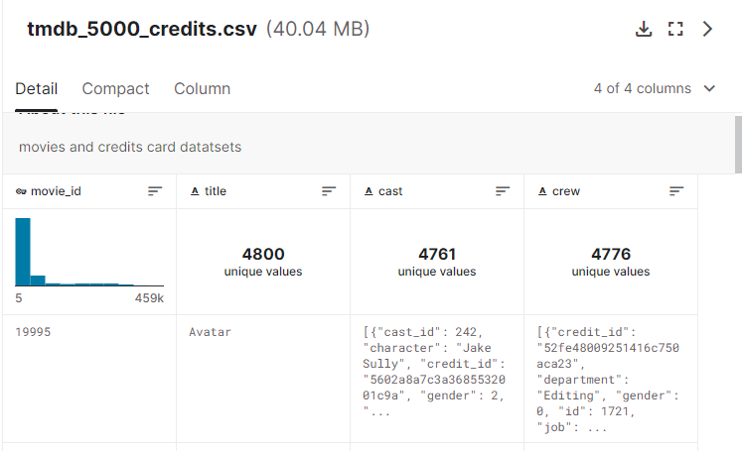
Dataset
Movie Recommendation System

Slide 13
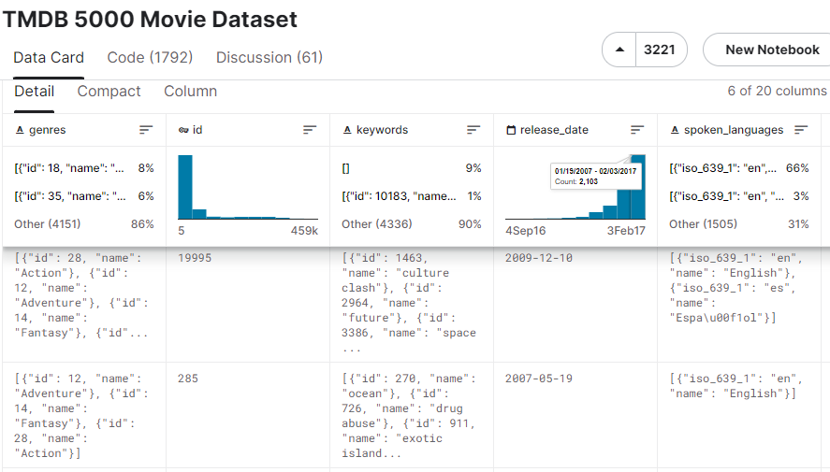
Dataset
Movie Recommendation System

Slide 14
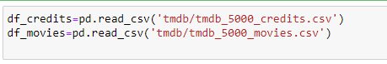
Dataset
- Import dataset
Columns we are interested in:
Id, title, overview, release_date, spoken_languages, keywords, vote_average, crew, cast
Movie Recommendation System

Slide 15
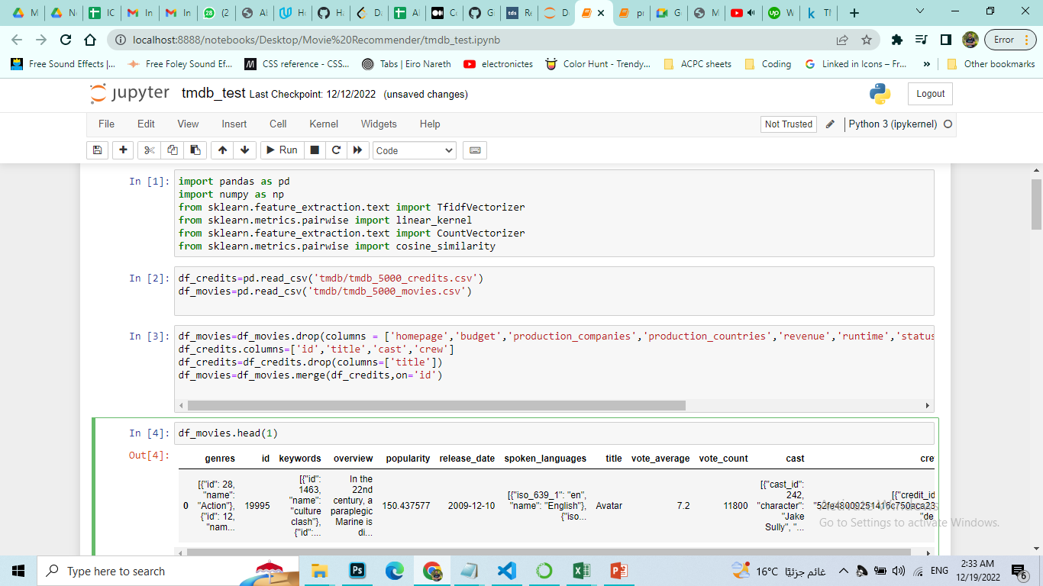
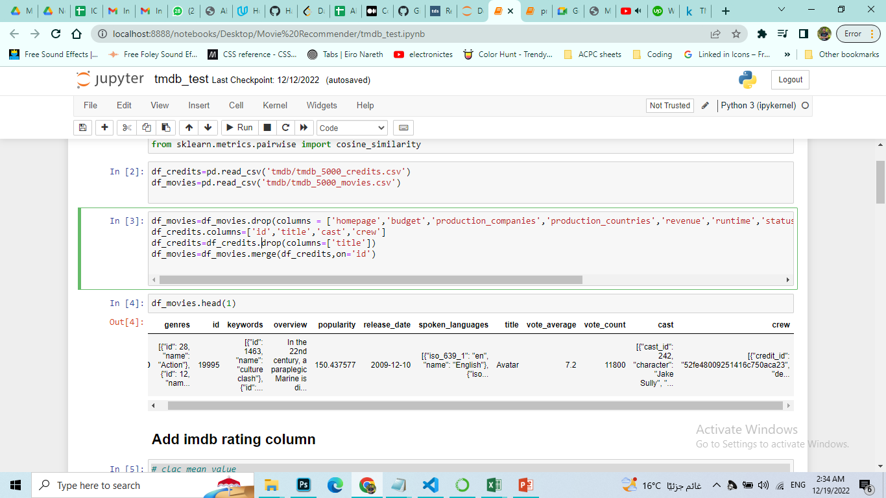
Dataset
Columns we are interested in:
Movie Recommendation System

Slide 16
Dataset
Data samples :-
Cast: [{"cast_id": 242, "character": "Jake Sully", "credit_id": "5602a8a7c3a3685532001c9a", "gender": 2, "id": 65731, "name": "Sam Worthington", "order": 0}, {"cast_id": 3, "character": "Neytiri", "credit_id": "52fe48009251416c750ac9cb", "gender": 1, "id": 8691, "name": "Zoe Saldana", "order": 1}]
Movie Recommendation System

Slide 17
Dataset
Data samples :-
Genres: [{"id": 28, "name": "Action"}, {"id": 12, "name": "Adventure"}, {"id": 14, "name": "Fantasy"}, {"id": 878, "name": "Science Fiction"}]
Movie Recommendation System

Slide 18
Data needs a lot of work!
Movie Recommendation System

Slide 19
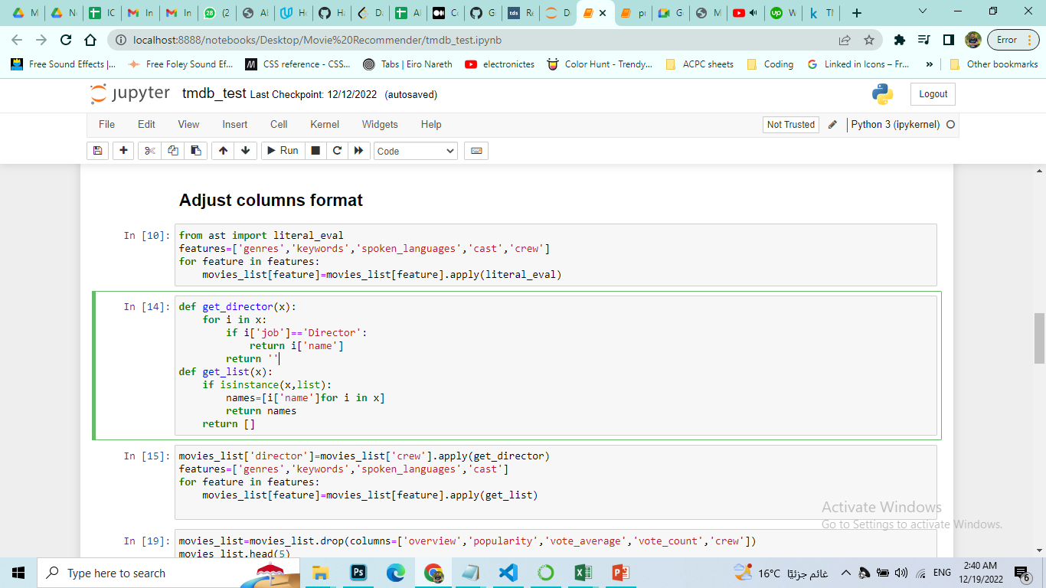
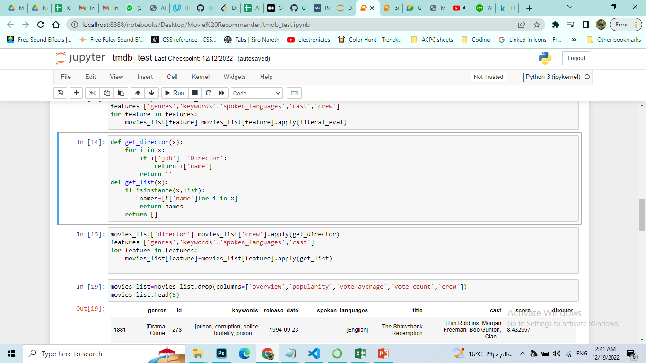
Cleaning
Convert strings to objects :-
Fetch needed data :-
Movie Recommendation System

Slide 20
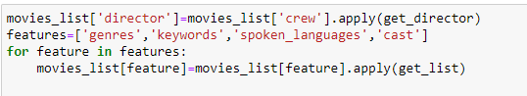
Cleaning
Fetch needed data :-
Movie Recommendation System

Slide 21
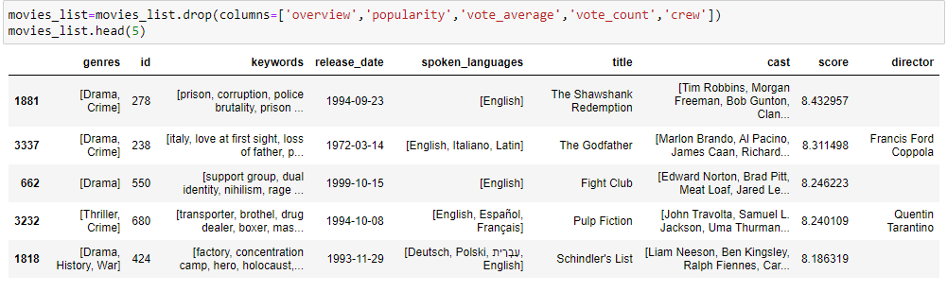
Cleaning
Movie Recommendation System

Slide 22
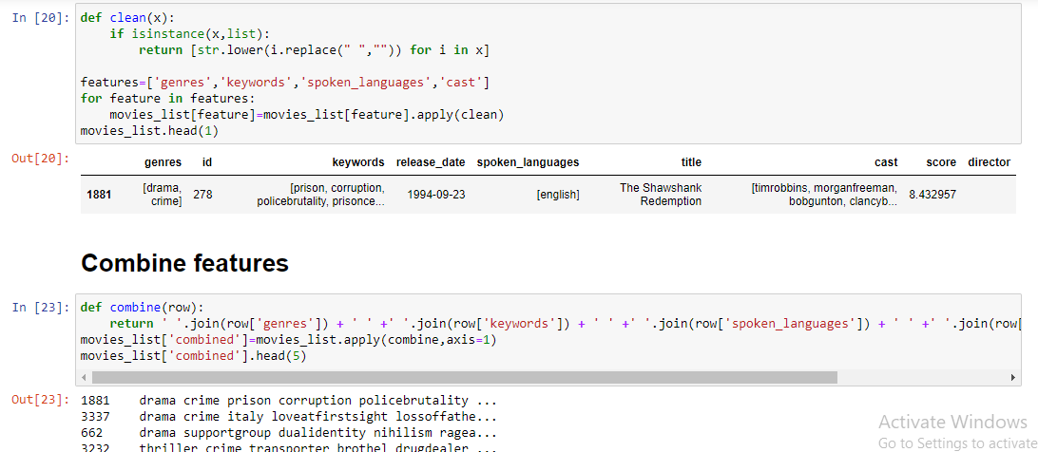
prepare data for count vectorizer
Movie Recommendation System

Slide 23
Count vectorizer :-
CountVectorizer is a great tool provided by the scikit-learn library in Python. It is used to transform a given text into a vector on the basis of the frequency (count) of each word that occurs in the entire text. This is helpful when we have multiple such texts, and we wish to convert each word in each text into vectors (for using in further text analysis).
Movie Recommendation System

Slide 24
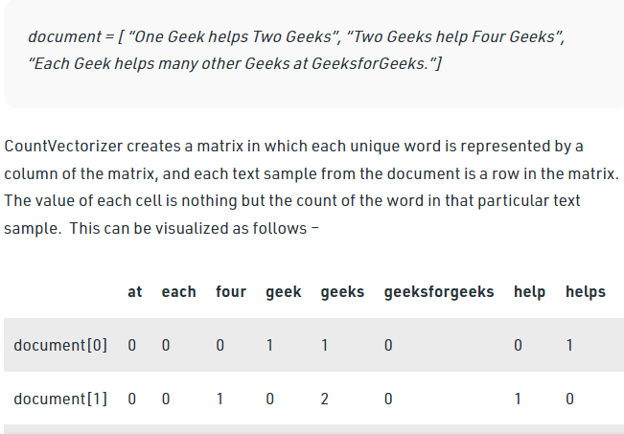
Count vectorizer :-
Movie Recommendation System

Slide 25
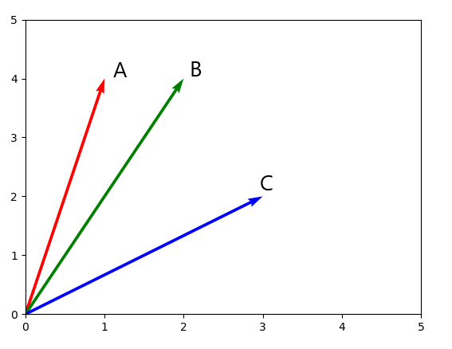
Cosine Similarity :-
Cosine similarity is a measure of similarity between two non-zero vectors. It is calculated as the angle between these vectors.
Movie Recommendation System

Slide 26
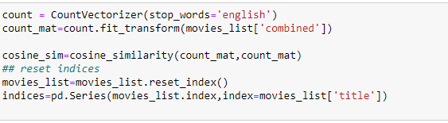
Implementation :-
Movie Recommendation System

Slide 27
Now we can predict by movie name
Movie Recommendation System

Slide 28
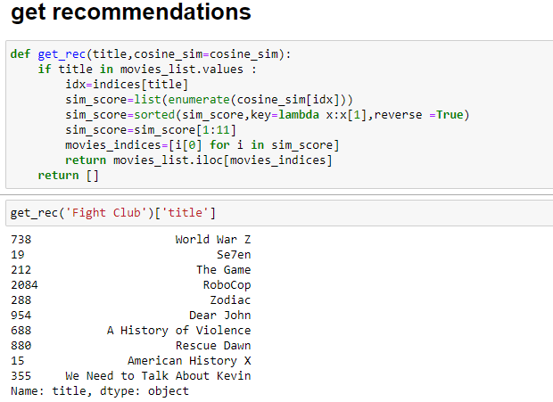
Prediction
Movie Recommendation System

Slide 29

One more feature in our system
User can enter any combination of features and get the closest 10 movies of his description!
Movie Recommendation System

Slide 30
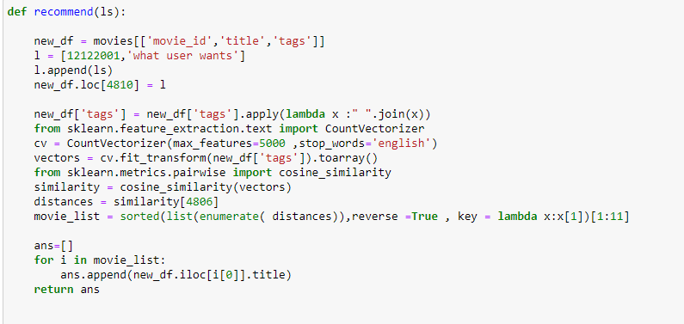
Prediction
Movie Recommendation System

Slide 31
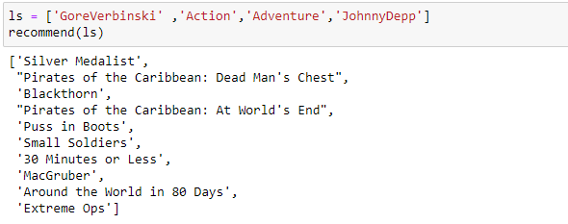
Prediction
Movie Recommendation System

Slide 32

And for more spaicy
We create our own Web app using Flask framwork!
Movie Recommendation System

Slide 33
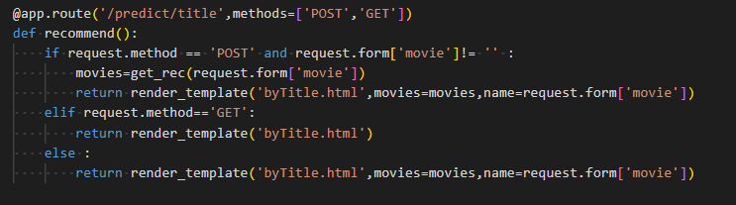
Backend
Predict by movie title route
Movie Recommendation System

Slide 34
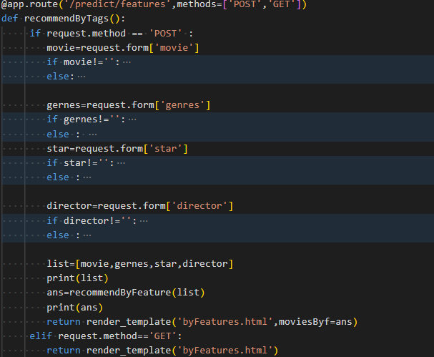
Backend
Predict by combination of features route
Movie Recommendation System

Slide 35
Show Time …
Movie Recommendation System

Slide 36

Movie Recommendation System

Slide 37
Thanks…
Movie Recommendation System

